Slide 1
Feasibility Analysis
System Analysis and Design
Content 04

Slide 2
SDLC Steps
Idea Generation (optional)
Planning
System Information/Requirement Gathering
Analysis
Design
Development/Construction/Coding
Testing
Deployment
Post–Implementation & Maintenance

Slide 3
Feasibility Analysis
Economical, Technical, HR, Behavioral, Legal & Schedule
Cash Flow & NPV
Feasibility Report
SWOT Analysis

Slide 4
What is Feasibility Analysis?
An assessment of the practicality/sustainability of any proposed project or system.
Determines the probability of the project being successful and practically beneficial for the organization.
The goal is to determine if the project is worth pursuing based on its feasibility.
Reduces risks, saves resources and meets objectives.

Slide 5
Feasibility Analysis - Types
Economical/Financial
Technical/Technological
Human Resources
Behavioral/Market
Legal/Political
Schedule

Slide 6

Economical Feasibility
Cost-Benefit Analysis
Expenses such as hardware and software resources required, design and development costs and operational/maintenance costs, potential revenue
Determine Profit/Loss
Carried out using Cash Flow or NPV methods

Slide 7
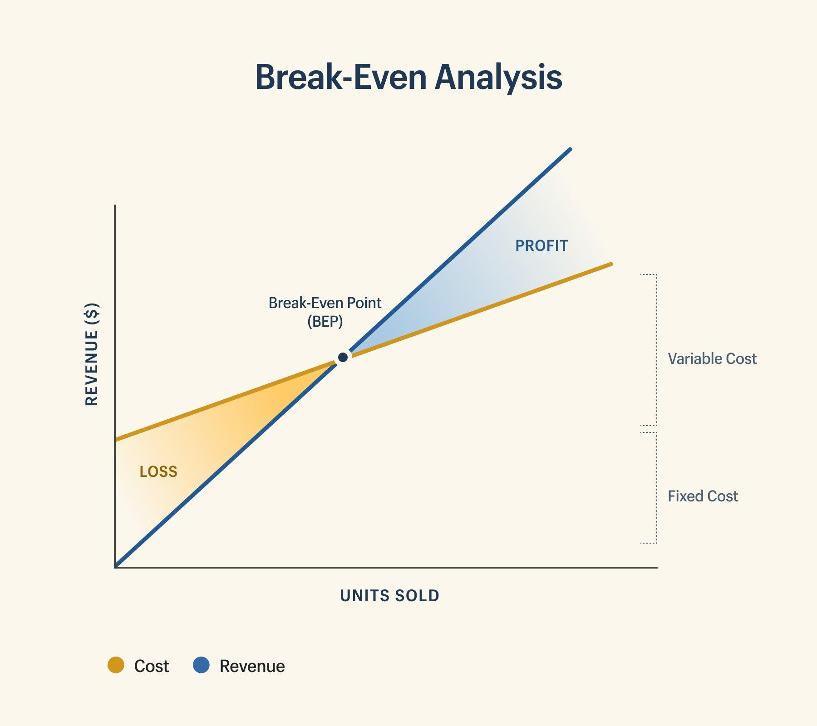
Break-Even Point
The point at which cost and income are equal and there is neither profit nor loss.
It is a financial result reflecting neither profit nor loss.

Slide 8
Classification of Costs
Tangible (costs that are obvious and measurable) or Intangible (costs that are hard to measure)
Fixed (Constant, unchanged) or Variable (Change with use)
Direct(Project-specific) or Indirect(General, shared)

Slide 9
Cash Flow & NPV
Suppose you are investing $5000, $4000 and $2000 at present, after 1 year and after 2 years respectively. In return after 2, 3 and 5 years you will get revenue $2000, $5000 and $7000 respectively.
Find out Profit / Loss through
Cash Flow Method
Net Present Value (NPV) Method
Consider bank interest 10%

Slide 10
Cash Flow
 | Year-0 | Year-1 | Year-2 | Year-3 | Year-4 | Year-5
Expenses | 5000 | 4000 | 2000 | 0 | 0 | 0
Revenue | 0 | 0 | 2000 | 5000 | 0 | 7000
Cash Flow = R-E | (5000) | (4000) | 0 | 5000 | 0 | 7000
Accumulating Cash Flow | (5000) | (9000) | (9000) | (4000) | (4000) | 3000
So, it is profitable, according to simple cash flow.
But, is it a true reflection?

Slide 11
Net Present Value (NPV)
Net Present Value (NPV) is a financial metric used to evaluate the profitability of an investment or project.
NPV takes into account the time value of money.

Slide 12
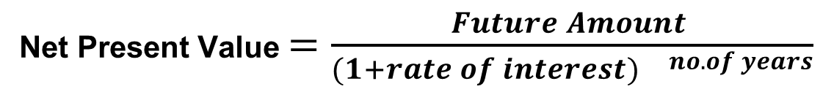
Net Present Value (NPV)
NPV = Return - Investment
if NPV > 0 − − − − Profit/Accept
if NPV < 0 − − − − Loss/Reject
if NPV = 0 − − − − No profit or loss

Slide 13
Net Present Value (NPV)
 | Year-0 | Year-1 | Year-2 | Year-3 | Year-4 | Year-5
Expenses | 5000 | 4000 | 2000 | 0 | 0 | 0
Expenses(NPV) | 5000 | 3636 | 1653 | 0 | 0 | 0
Revenue | 0 | 0 | 2000 | 5000 | 0 | 7000
Revenue (NPV) | 0 | 0 | 1653 | 3757 | 0 | 4346
Cash Flow (NPV) = R-E | (5000) | (3636) | 0 | 3757 | 0 | 4346
Accumulating Cash Flow (NPV) | (5000) | (8636) | (8636) | (4879) | (4879) | (533)
Not profitable when NPV calculated.

Slide 14
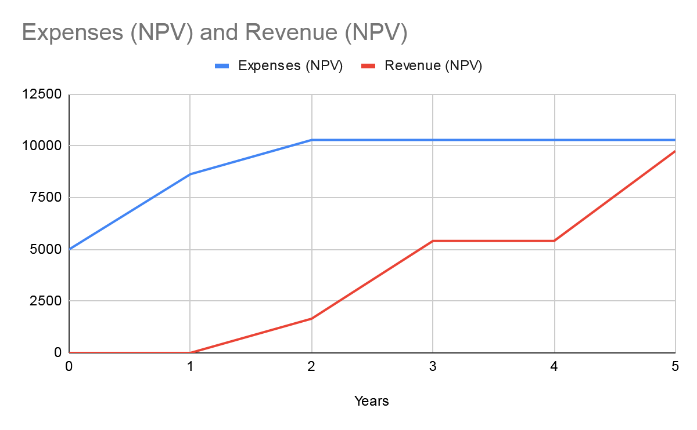
Cash Flow & NPV
From the graph, we can see that Expenses are greater than Revenue.

Slide 15
Cash Flow & NPV
Suppose you invested in a business with capital $20,000 and the cash flow of the business are $5000, $6000, $8000, $7000 and $4000 after years 1,2,3,4 and 5 respectively.
Find out Profit / Loss through NPV Method.
Consider bank interest of 8%.

Slide 16
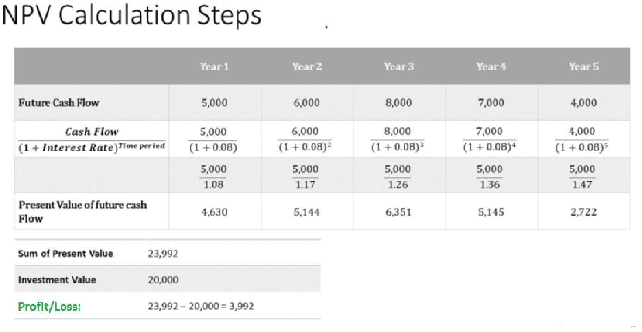

Slide 17

2) Technical Feasibility
Analyzes hardware and software requirements
Determines whether existing technology or technology at hand supports the project

Slide 18

3) Human Resources Feasibility
Evaluates project/team members
Ensures that there are sufficient skilled human resources to get the job done.

Slide 19
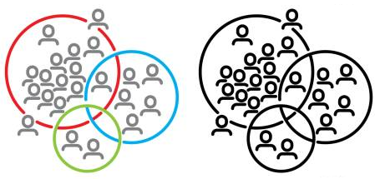
4) Behavioral Feasibility
Evaluates the market’s willingness and ability to accept the suggested software system.
Analyzing the target market and understanding consumer demands are part of this study.
Factors may include demographic, social, cultural, academic and psychological data.

Slide 20

5) Legal Feasibility
Know if proposed project conform legal and ethical requirements.
Analyzes barriers of legal implementation of project, data protection acts or social media laws, project certificate, license, copyright etc.

Slide 21

6) Schedule Feasibility
Evaluates the deadline based on the given resources.

Slide 22
Steps in Feasibility Study
Form a project team and appoint a project leader.
Mention potential candidate systems.
Describe and identify characteristics of candidate systems.
Determine and evaluate performance and cost effectiveness of each candidate system.
Weight system performance and cost data.
Select the best candidate system.
Prepare final report

Slide 23
Feasibility Report
Introduction
Methods and procedures
Facts and details
Discussion and analysis of facts and details
Recommendations
Conclusion

Slide 24
Feasibility Report Templates
https://mymanagementguide.com/feasibility-study-template/
https://www.tpsgc-pwgsc.gc.ca/biens-property/sngp-npms/ti-it/etivcarftp-idsfvfrmd-eng.html

Slide 25
SWOT Analysis
Planning process that helps a company overcome challenges and determine which new leads to pursue.
Carried out when exploring new initiatives, revamping internal policies, considering opportunities to pivot or altering a plan midway through its execution.

Slide 26
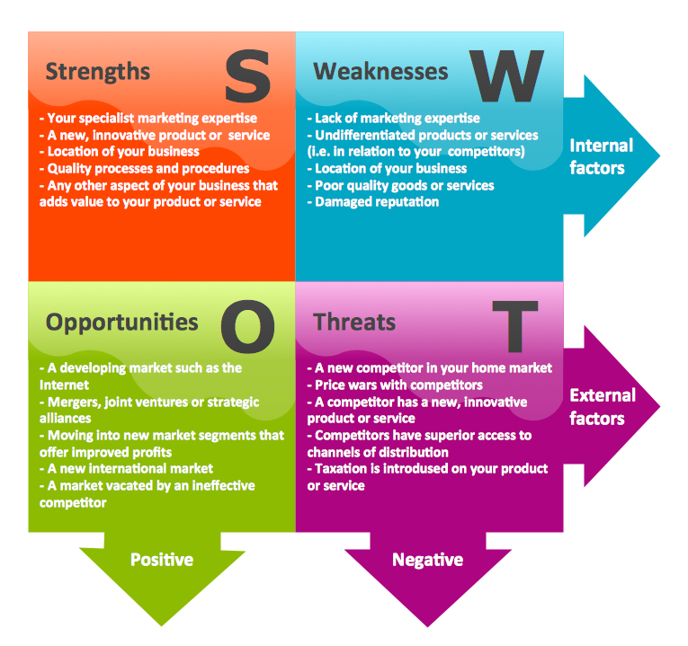

Slide 27
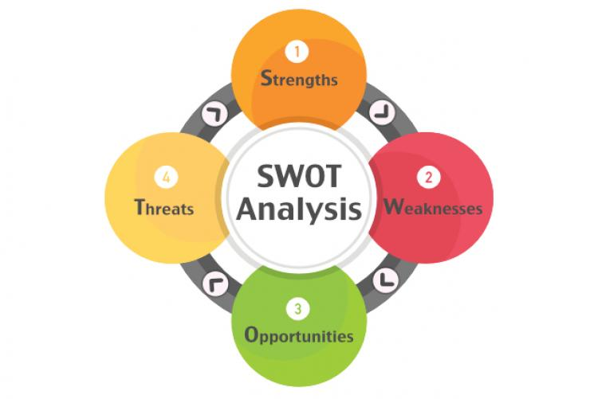
Strengths
We have sufficient financial resources to participate in such project
Core competence in the key areas
Better advertising campaigns
Acknowledged market leader

Slide 28
Weaknesses
Don't paying much attention to marketing
Website purely informational and static
Don't have a marketing plan
Don't have much of a marketing budget

Slide 29
Opportunities
Few companies
Emerging need of the product
Sufficient workforce
Take advantage of increasing popularity of booking system

Slide 30
Threats
Customer’s Diversion
Cost of technology
Unloyal partners
Other booking business in town; competition rising

Slide 31
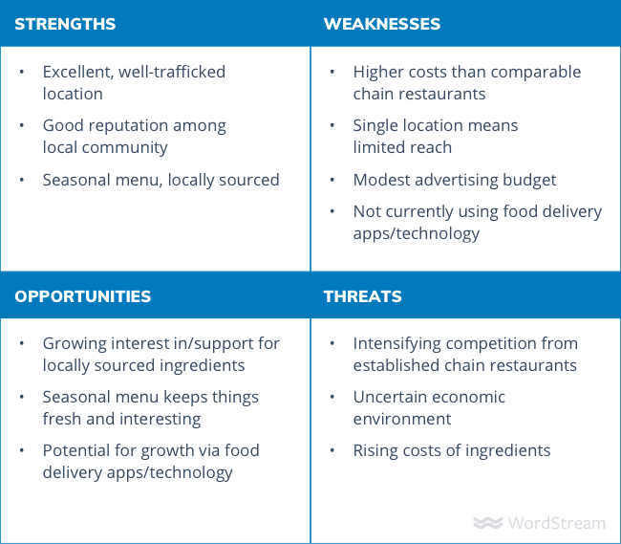
SWOT Analysis - Example
Suppose a family-owned restaurant, with a single location, is operating in an urban area.

Slide 32
Practice
A small, successful organic grocery store, GreenHarvest, has been operating in a local neighborhood for five years. The store specializes in fresh, organic produce, dairy, and handmade food products.One evening, the store owner, notices a sharp drop in sales. She overhears a regular customer saying,
"I love GreenHarvest, but it's just easier to order from the supermarket app. They deliver in 30 minutes!"
This makes Ayesha realize that shopping habits are changing—people prefer online convenience over physical stores. She considers launching an online ordering system with home delivery, but this decision comes with risks.

Slide 33
References
https://medium.com/@aquariousdigitalmarketing/software-feasibility-study-a-step-by-step-guide-54ac0f96c07d
https://www.geeksforgeeks.org/types-of-feasibility-study-in-software-project-development/
https://www.shutterstock.com/image-vector/taka-bdt-bangladeshi-currency-icon-logo-1638072163
https://www.freepik.com/free-photos-vectors/technology
https://www.vectorstock.com/royalty-free-vector/human-resources-recruiting-concept-vector-9732886
https://www.istockphoto.com/photos/behavioral-data
https://www.istockphoto.com/photos/data-privacy-law
https://www.vecteezy.com/free-vector/schedule
https://www.businessnewsdaily.com/4245-swot-analysis.html
https://www.wordstream.com/blog/ws/2017/12/20/swot-analysis

Slide 34
Thank You

